Slide 1



INDUSTRIAL USE CASES
PREDICTIVE MODELLING ANALYTICS
AADHI GOWTHAM V S (927621BAD001)
AARTHI R (927621BAD002)
ABISHEK D (927621BAD003)

Slide 2

PROBLEM STATEMENT
In the realm of pharmaceutical research, the process of drug discovery is intricate, time-consuming, and resource-intensive. The traditional methods of identifying potential drug candidates often lead to a high rate of failure in later stages of development, resulting in significant financial and temporal setbacks. To address this challenge, there is a pressing need to integrate advanced predictive modeling techniques into the drug discovery pipeline.

Slide 3

ABOUT INDUSTRY:
INDUSTRY NAME: Bio Tech Innovations
EXPLANATION
Bio Tech Innovations, a trailblazing player in the pharmaceutical industry, stands at the forefront of technological innovation. Recognizing the challenges inherent in traditional drug discovery methods, the company has strategically embraced advanced predictive modeling techniques to revolutionize the drug development pipeline.

Slide 4

SOLUTION
To tackle the intricate, time-consuming, and resource-intensive nature of drug discovery, a comprehensive solution involves the strategic integration of advanced predictive modeling techniques. In this context, we'll explore a systematic approach using an imaginary company, "Bio Tech Innovations," as an illustrative example.

Slide 5
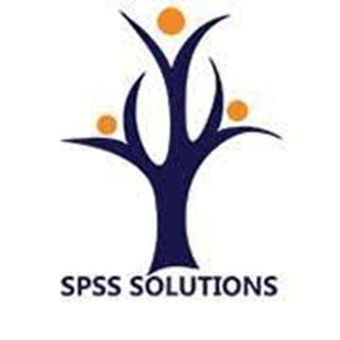
SOLUTION EXPLANATION
Infrastructure Setup:
Bio Tech Innovations invests in a robust Predictive Modeling Infrastructure with cutting-edge computational resources and a team comprising skilled data scientists, biostatisticians, and computational biologists.
Data Integration:
Implementation of a standardized approach to data collection, integration, and curation to ensure dataset quality and reliability. Protocols are established for harmonizing diverse data types, including genomics, proteomics, and chemical data, fostering a holistic view for predictive modeling.

Slide 6
Algorithm Development:
Bio Tech Innovations intensifies research efforts to develop and refine advanced algorithms for predictive modeling. Leveraging machine learning, artificial intelligence, and deep learning approaches enhances the accuracy and predictive power of the models.
Cross-Functional Collaboration:
Encouraging collaboration between biologists, chemists, data scientists,
and clinicians, Bio Tech Innovations forms interdisciplinary teams to facilitate a comprehensive understanding of the drug discovery process. These teams work collaboratively to integrate predictive modeling into various stages of drug development

Slide 7
Continuous Learning:
Bio Tech Innovations implements a continuous learning framework, regularly updating models based on new data and insights. This adaptive approach ensures that predictive models remain at the forefront of scientific advancements, maximizing their effectiveness in identifying potential drug candidates.
Explainable AI Integration:
To enhance the interpretability of predictive models, Bio Tech Innovations integrates explainable AI techniques. This allows researchers and stakeholders to understand the reasoning behind model predictions, fostering trust in the decision-making process.

Slide 8
Validation and Testing:
Implementing rigorous validation and testing protocols to ensure the reliability and reproducibility of predictive models. BioTech Innovations establishes standardized procedures for model validation using historical data and blinded datasets to assess predictive accuracy.
Real-time Monitoring:
A real-time monitoring system is implemented to track the performance of predictive models in ongoing drug discovery projects. A feedback loop allows for adjustments and improvements based on performance metrics and outcomes in real-world applications.

Slide 9
Expected Outcomes
Early Identification of Promising Candidates:
Refined predictive models enable BioTech Innovations to identify potential drug candidates early, minimizing late-stage failures and optimizing resource allocation.
Accelerated Drug Development:
Streamlining the drug discovery process anticipates a significant reduction in development timelines, facilitating quicker translation from discovery to clinical applications.
Cost Savings and Improved Success Rates:
Optimized resource allocation and accurate candidate selection result in substantial cost savings and higher success rates in clinical trials, mitigating financial risks.
Innovation in Personalized Medicine:
Predictive modeling empowers BioTech Innovations to tailor drug development for personalized medicine, aligning treatment approaches with individual patient characteristics.

Slide 11

YOU!
THANK

